Slide 1

DATA ANALYTICS & VISUALISATION ECM(3001)
SUBMITTED BY: ABHYUDAY SINGH (18BLC1159) PRERIT AGRAWAL (18BLC1156) NOV2020
Collaborative Filtering for Movie Recommendations

Slide 2
Recommendation System
What is a Recommendation System?
A recommendation system generates a compiled list of items in which a user might be interested, in the reciprocity of their current selection of item(s). It expands users’ suggestions without any disturbance or monotony, and it does not recommend items that the user already knows.
For instance, the Netflix recommendation system offers recommendations by matching and searching similar users' habits and suggesting movies that share characteristics with films that users have rated highly.

Slide 3
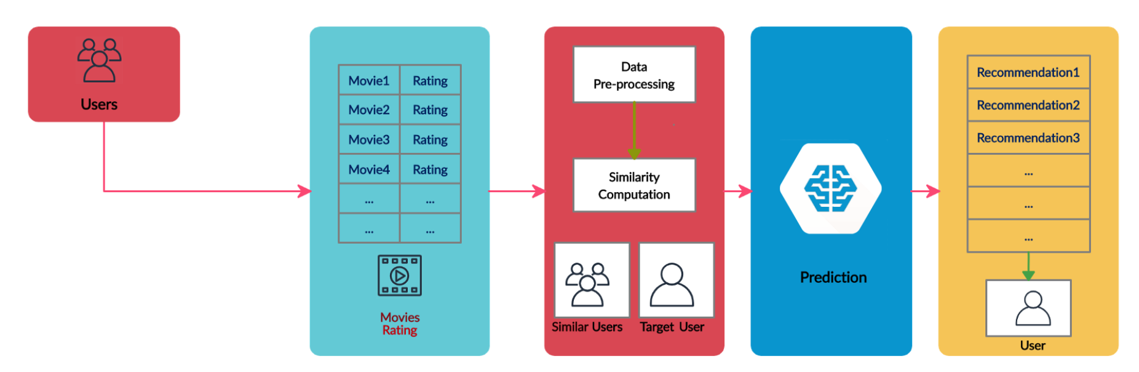
Block diagram

Slide 4
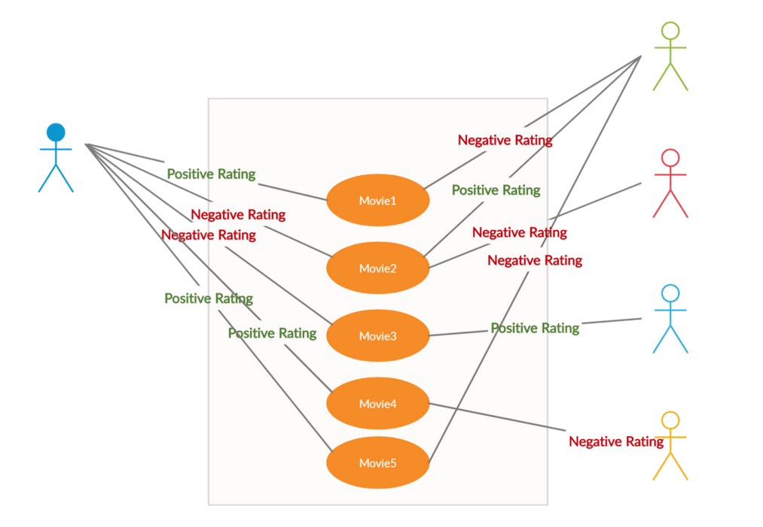
For Collaborative Filtering

Slide 5
Collaborative Filtering
The idea behind collaborative filtering is to consider users’ opinions on different movies and recommend the best movies to each user based on the user’s previous rankings and the opinion of other similar types of users.
We are using here two types of CF :
1.) User-based nearest neighbor.
2.)Item-based nearest neighbor.

Slide 6
User-based Nearest Neighbor
The basic technique of user-based Nearest Neighbor for the user John:
John is an active Netflix user and has not seen a video “v” yet. Here, the user-based nearest neighbor algorithm will work like below:
The technique finds a set of users or nearest neighbors who have liked the same items as John in the past and have rated video “v.”
Algorithm predicts.
Performs for all the items John has not seen and recommends.
Essentially, the user-based nearest neighbor algorithm generates a prediction for item i by analyzing the rating for i from users in u’s neighborhood.

Slide 7
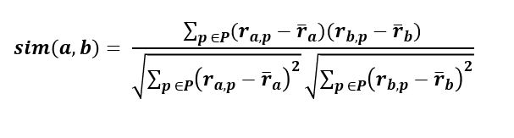
calculating user similarity for the prediction
a, b = Users
r(a, p)= Rating of user a for item p
P = Set of items. Rated by both users a and b

Slide 8
Item-based Nearest Neighbor
This technique generates predictions based on similarities between different videos or movies or items.
Prediction for a user u and item i is composed of a weighted sum of the user u’s ratings for items most similar to i.
Role of Cosine Similarity in building Recommenders
The cosine similarity is a metric used to find the similarity between the items/products irrespective of their size. We calculate the cosine of an angle by measuring between any two vectors in a multidimensional space. It is applicable for supporting documents of a considerable size due to the dimensions.

Slide 9
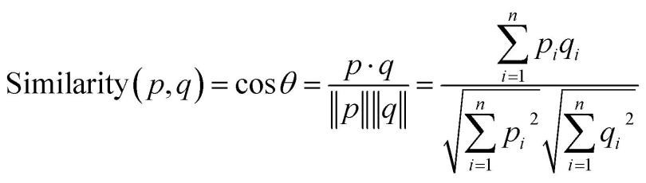
Calculating cosine similarity
Where:
cosine is an angle calculated between -1 to 1 where -1 denotes dissimilar items, and 1 shows items which are a correct match.
cos p. q — gives the dot product between the vectors.
||p|| ||q|| — represents the product of vector’s magnitude

Slide 10
Problem Statement
Netflix, Amazon etc. is a platform that provides online movie and video streaming. They wants to build a recommendation system to predict a list of movies for users based on other movies likes or dislikes. This recommendation will be for every user and similar movie based on his/her unique interest.
Dataset
ratings.csv: This CSV file contains movie_id, customer_id, rating, timestamp
movies.csv: This CSV file contains movie_id and movie_title

Slide 11

Jupyter notebook
The Jupyter Notebook is an open-source web application that allows you to create and share documents that contain live code, equations, visualizations and narrative text. Uses include: data cleaning and transformation, numerical simulation, statistical modeling, data visualization, machine learning, and much more.
Here, we are using python to apply our idea , on jupyter notebook.

Slide 12
What we are doing?
First we will make training algorithm based on item to item based CF.
Using cosine similarity and collaborative filtering
According to our dataset we will predict top movies based on item to item CF.
Secondly, we will be using item to item based CF.
On the basis of same movies liked by user ,we will built training model.
Using our dataset we will find top recommended movies by item based filtering.
We will than take top 9 movies from each method and merge them adjacently from consecutive filtering techniques.

Slide 13
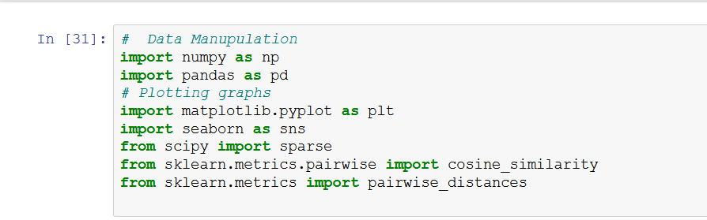
IMPORTING LIBRARIES

Slide 14
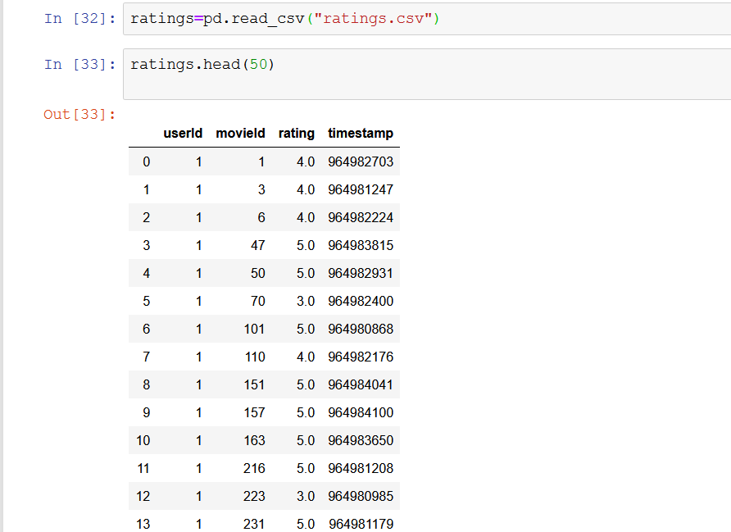
LOADING DATASET

Slide 15
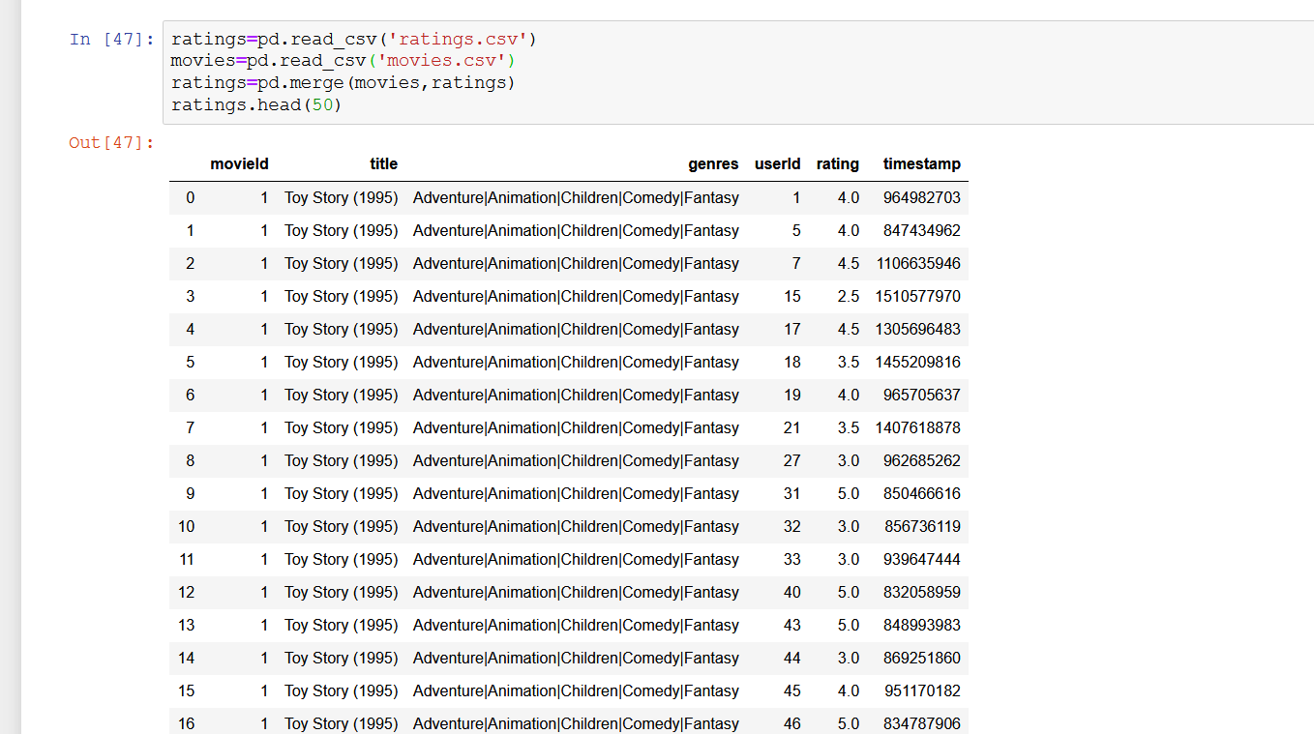
MERGING MOVIE ID WITH ITS TITLE

Slide 16
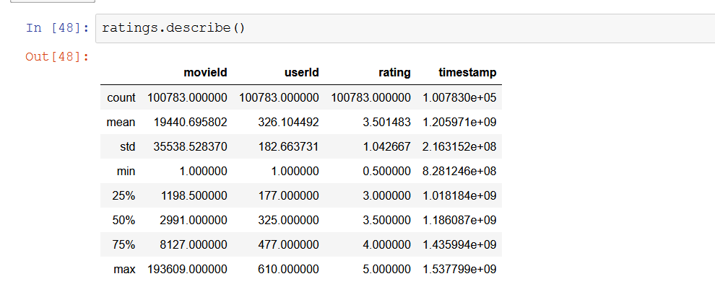
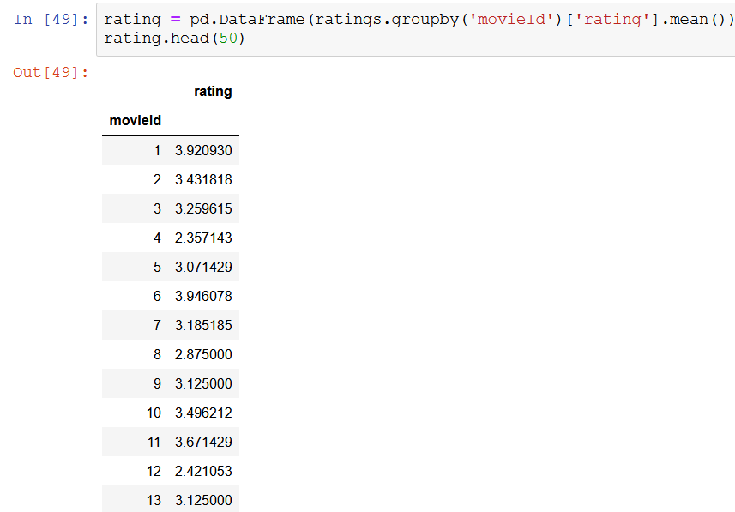
DESCRIPTION ABOUT DATASET AND AVG RATING OF EACH MOVIE

Slide 17
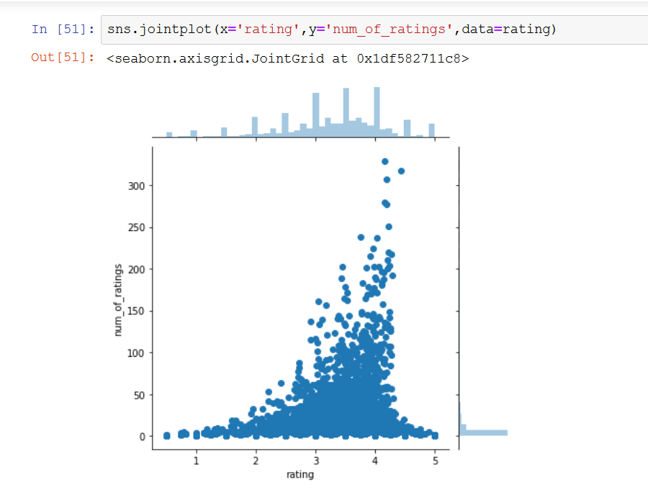
GRAPHICAL REPRESENTATION OF EACH RATING

Slide 18
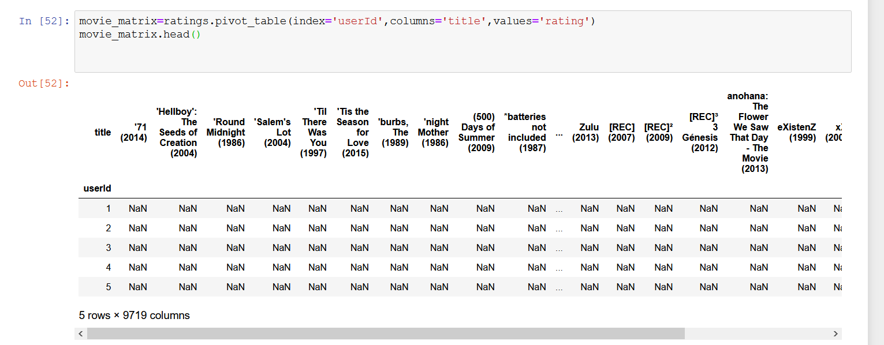
PIVOTING MOVIE’S AS ROW & USER’S AS COLUMN IN A MATRIX WITH RATING AS VALUE BY USER TO EACH MOVIE

Slide 19
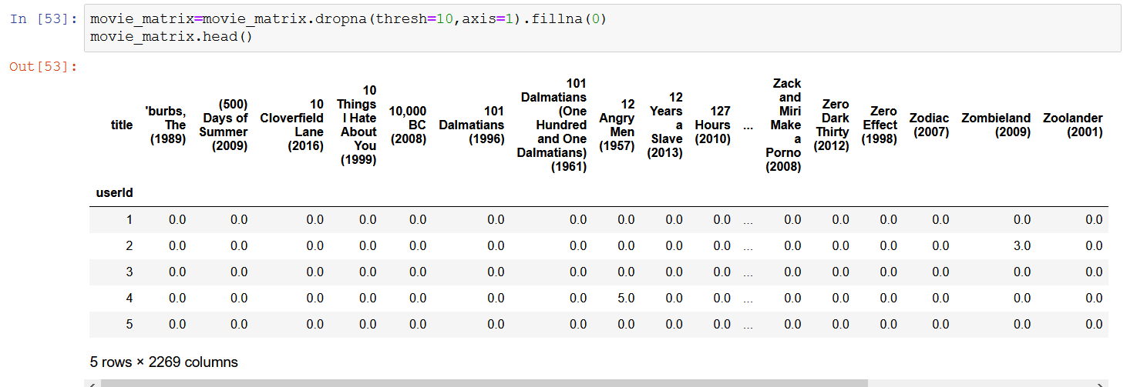
REPLACING RATING BY 0 WHERE USER HADN’T REACTED

Slide 20
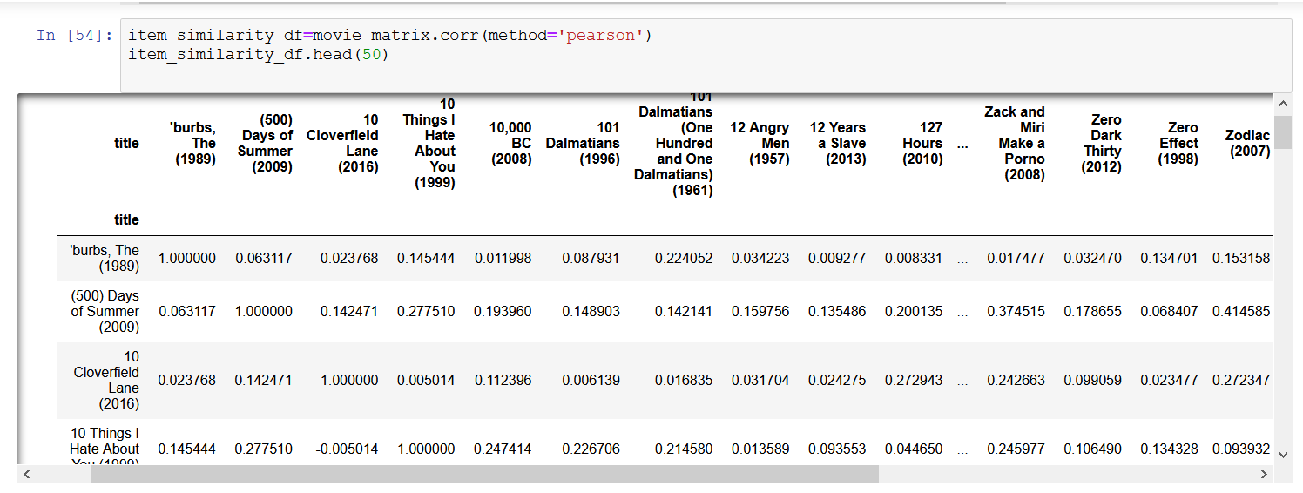
CONVERTING IT INTO ITEM BASED FILTERING , MAKING ROW AND COLUMN AS MOVIES

Slide 21
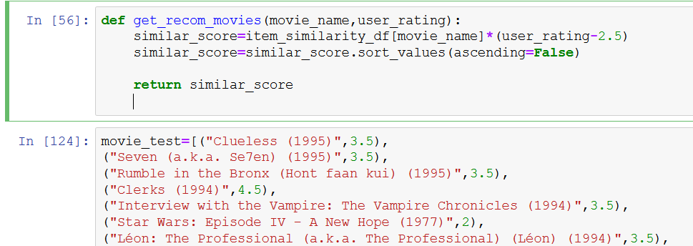
DEFINING FUNCTION TO GET SCORE ACCORDING TO COSINE SIMILARITY AND WE USED USER no.370 , AND PUTTED ITS DATA OF RATING IN TRAINING MODEL TO GET RECOMMENDATIONS

Slide 22
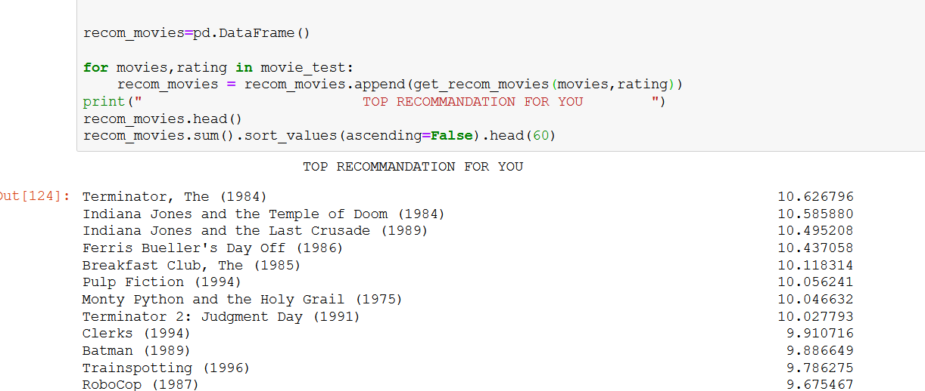
WE GET TOP RECOMMENDATION USING ITEM BASED FILTERING

Slide 23
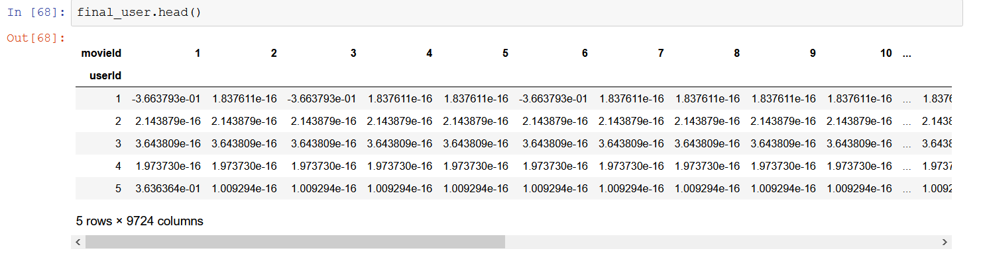
NOW IMPLEMENTING USER BASED FILTERING
NOW BY FINDING SIMILARITY COEFICIENT BETWEEN DIFFERENT USERS , WE HAVE FOLLOWING MATRIX

Slide 24
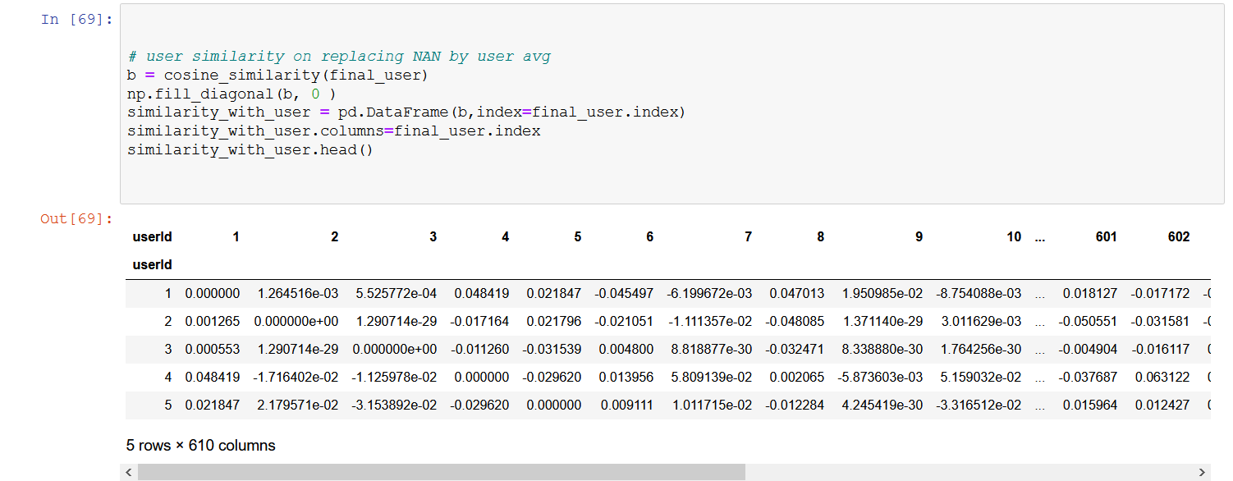
BY TRANSPOSING ABOVE MATRIX AND MULTIPLYING WITH SAME , WE WILL GET SIMILARITY COEFICIENT BETWEEN DIFFERENT USERS

Slide 25
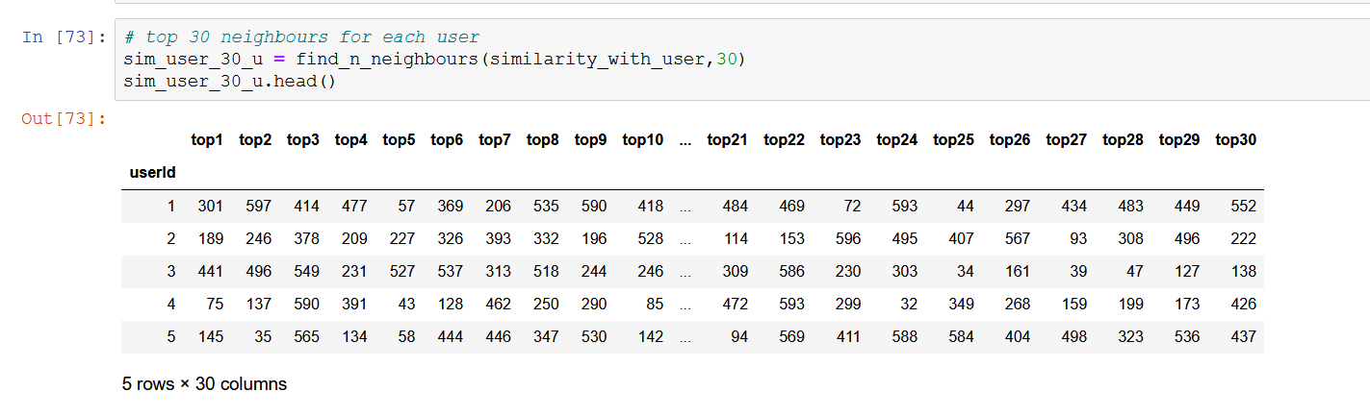
TOP 30 SIMILAR USERS TO A PARTICULAR USER

Slide 26
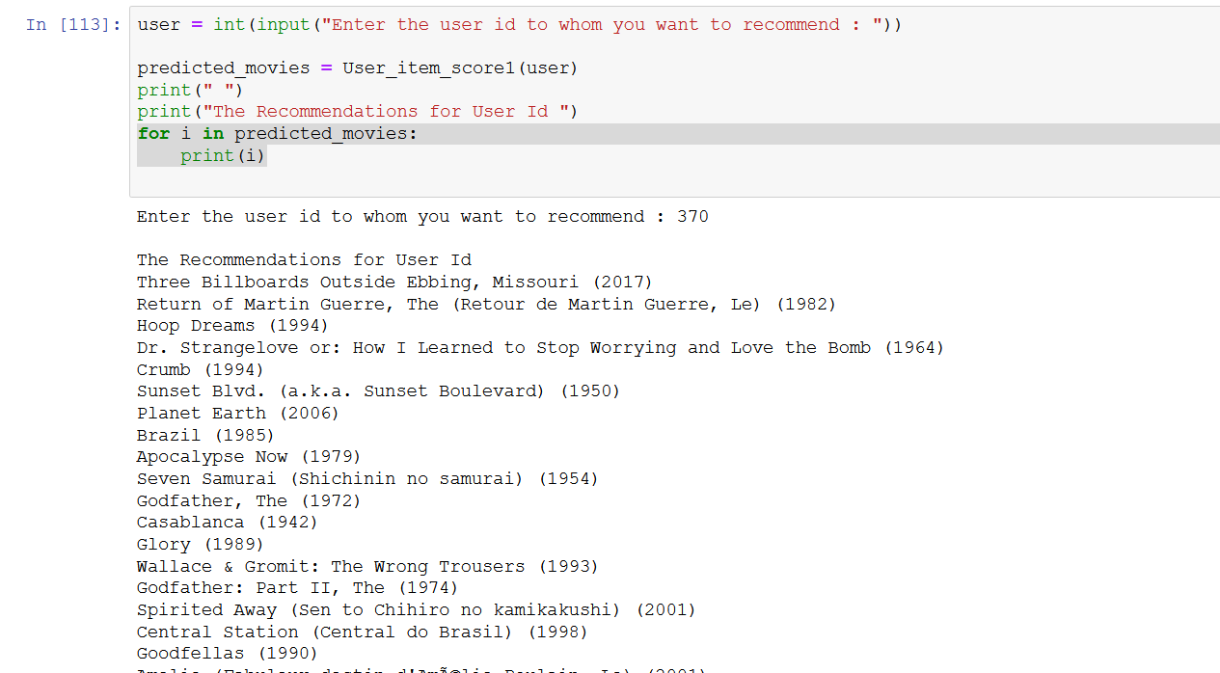
TOP MOVIES RECOMMENDED BY USER BASED FILTERING OF USER:370

Slide 27
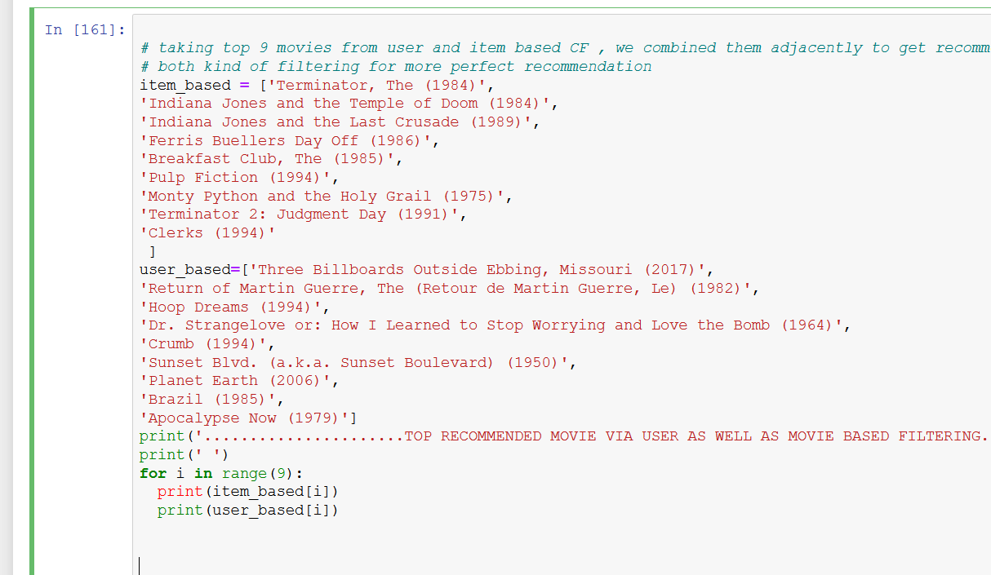
taking top 9 movies from user and item based CF , we combined them adjacently to get recommendation which involve both kind of filtering for more perfect recommendation

Slide 28
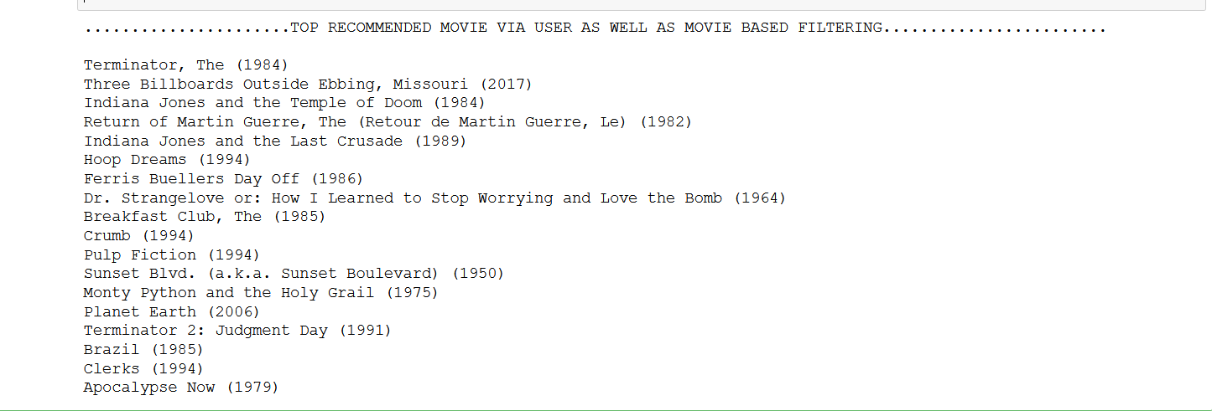
FINAL RECOMMENDATIOM TO USER 370

Slide 29
result
Collaborative filtering (CF) is a very popular recommendation system algorithm for the prediction and recommendation based on other users’ ratings and collaboration. User-based collaborative filtering was the first automated collaborative filtering mechanism. It is also called k-NN collaborative filtering. The problem of collaborative filtering is to predict how well a user will like an item that he has not rated given a set of existing choice judgments for a population of users .
ITEM –BASED CF has given different results from user based , so for more accuracy we should consider each angle for getting recommendation , and different algorithm to predict movies , so at last we can merge output of each training model and get more precise results.
Conclusion
Over the years, Machine learning has solved several challenges for companies like Netflix, Amazon, Google, Facebook, and others. The recommender system for Netflix helps the user filter through information in a massive list of movies and shows based on his/her choice. A recommender system must interact with the users to learn their preferences to provide recommendations.

Slide 30
Future work
We used two types of CF model to train our model.
There are many more types of recommendation algorithms.
Making training model from all possible algorithms, like Content filtering recommender systems, Reducing dimensionality algo ,Probabilistic algorithm like Bayesian-network model,EM algorithm etc.
So using this we can get several recommendation , and merge top movies from each algo.
So at last we will have best recommendation considering each angle , make our model more accurate.

Slide 31
References:
[1] How retailers can keep up with consumers, McKinsey & Company, https://www.mckinsey.com/industries/retail/our-insights/how-retailers-can-keep-up-with-consumers
[2] How Netflix’s Recommendation System Works, Netflix Research, https://help.netflix.com/en/node/100639
[3] Recommendations, Figuring out how to bring unique joy to each member, Netflix Research, https://research.netflix.com/research-area/recommendations
[4] Collaborative Filtering, University of Pittsburgh, Peter Brusilovsky, Sue Yeon and Danielle Lee, https://pitt.edu/~peterb/2480-122/CollaborativeFiltering.pdf

